Slide 1
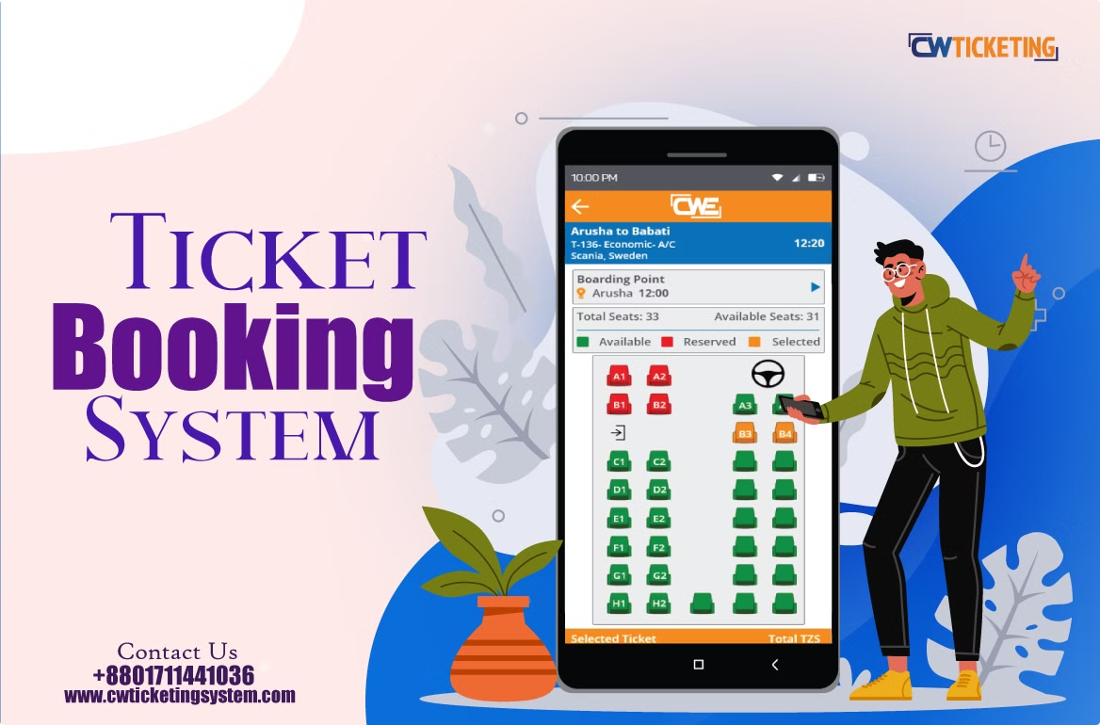


Bus Management System
Welcome!
This presentation introduces our team and our project.
Group Leader: Md Abdullah
Team Members:
Nitu Khorshed
Nure Jannat
Al Amin
Tasliima Tanjin Tanha

Slide 2
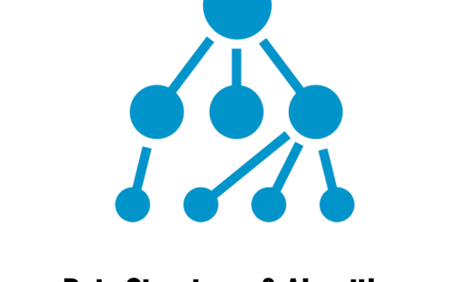
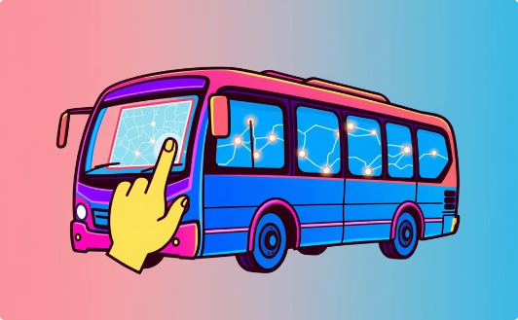
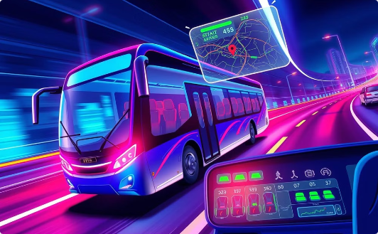
Objectives
Flexible System
User Interaction
Efficient Management
Create system using various data structures.
Allow booking, cancellation, and route visualization.
Implement real-time route and seat management.

Slide 3
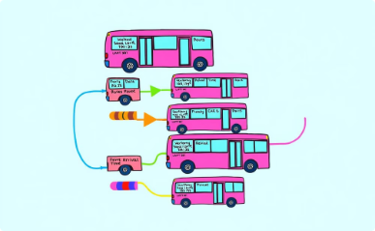
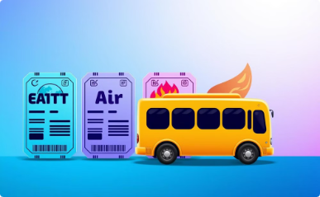
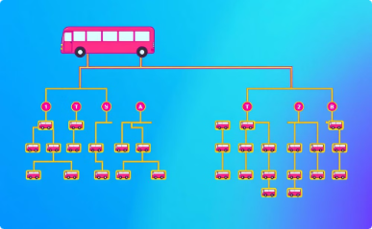
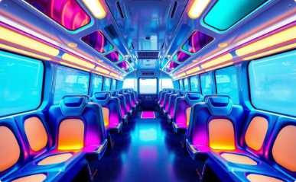
Data Structures Used
Linked List
Queue
Tree
2D Array
Stores bus and user data.
Manages seat reservations (FIFO).
Enables efficient route visualization.
Represents seat layout.

Slide 4

Dynamic Route Management
1
Route Addition
Add new bus routes using tree structure.
2
Route Deletion
Delete existing routes by users and admins.
3
Route Modification
Update route details as needed.
4
Fare Calculation
Automatic calculation based on distance and bus type.

Slide 5
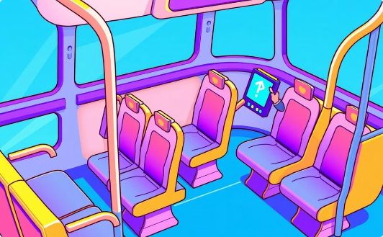


Booking and Payment
Seat Booking
Payment Options
Discounts
Choose your bus and reserve your seats dynamically.
Enjoy multiple convenient payment methods.
Special rates are offered to customers who pay online.

Slide 6




Enhanced Features
Real-Time Tracking
Personalized Recommendations
Multi-Lingual Support
Loyalty Program
Reward frequent travelers with redeemable points.
Track bus locations in real-time.
Interface supports multiple languages.
Suggest routes based on user preferences.

Slide 7
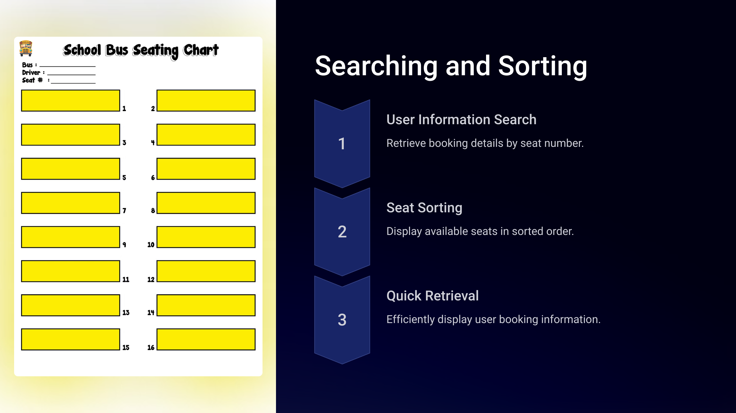

Slide 8
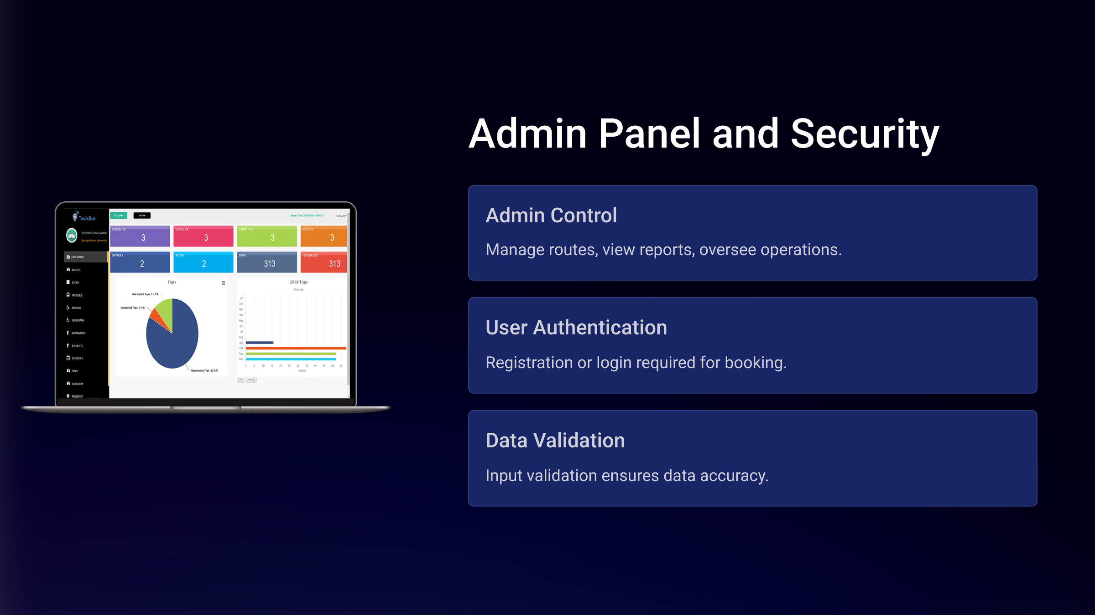

Slide 9


Challenges and Conclusion
Dynamic Memory Management
Efficient Searching
Real-Time Updates
Managing memory for structures
Implementing efficient algorithms
Ensuring consistent updates
System integrates data structures for user-friendly bus management interface.

Slide 10
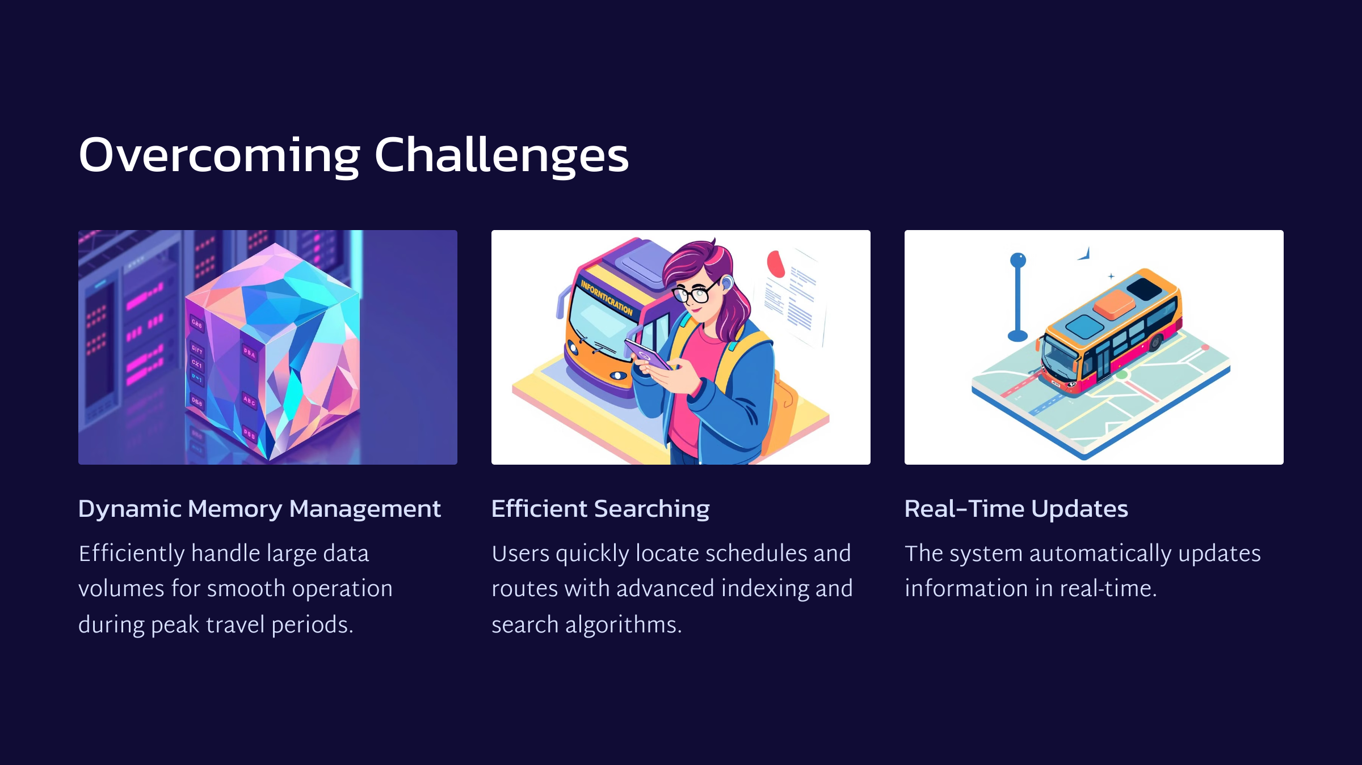

Slide 11


Slide 12


